Slide 1
OGC API Hackathon 2019
London, United Kingdom
20 June 2019

Slide 2
Day 1 – Thursday 20 June 2019
09:00hrs - Welcome note (Geovation Hub Staff)
09:15hrs - Goals and objectives (OGC DKM & SWG Chairs)
09:30hrs - Introduction to the Draft Specifications (Common, Features, Map Tiles, Processes, Coverages)
11:00hrs – Split into teams by specification
11:10hrs – Team-based work starts [define the problem/scope]
12:30hrs - Lunch
13:30hrs - Resume [come up with multiple options]
17:00hrs - Early Dinner
18:00hrs - Resume [select the preferred option]
20:00hrs - Back-briefs from each team
21:00hrs - Adjourn

Slide 3
Day 2 – Friday 21 June 2019
08:00hrs - Goals and objectives (OGC DKM & SWG Chairs)
08:30hrs - Resume team-based work [implement the preferred option]
12:00hrs - Third back-briefs from each team [ "alignment report" to brief on any deviation from Core as provided at start]
12:30hrs - Working Lunch [complete implementation of the preferred option]
13:30hrs – Joint work on Common or Resume team-based work [implement the preferred option]
14:30hrs – Show & Tell (Demonstration of clients accessing services)
15:30hrs - Final back-briefs
16:30hrs - Closing note (OGC COO)
17:00hrs - Close

Slide 4

Goal & Objectives
Goal
To advance the development of OGC API specifications
Objectives
Develop, deploy and test services/clients that support OGC APIs
Suggest improvements for a common core
Define rules/guidance that can be documented
Validate work that has been completed to date
Contribute to the GitHub repos

Slide 5
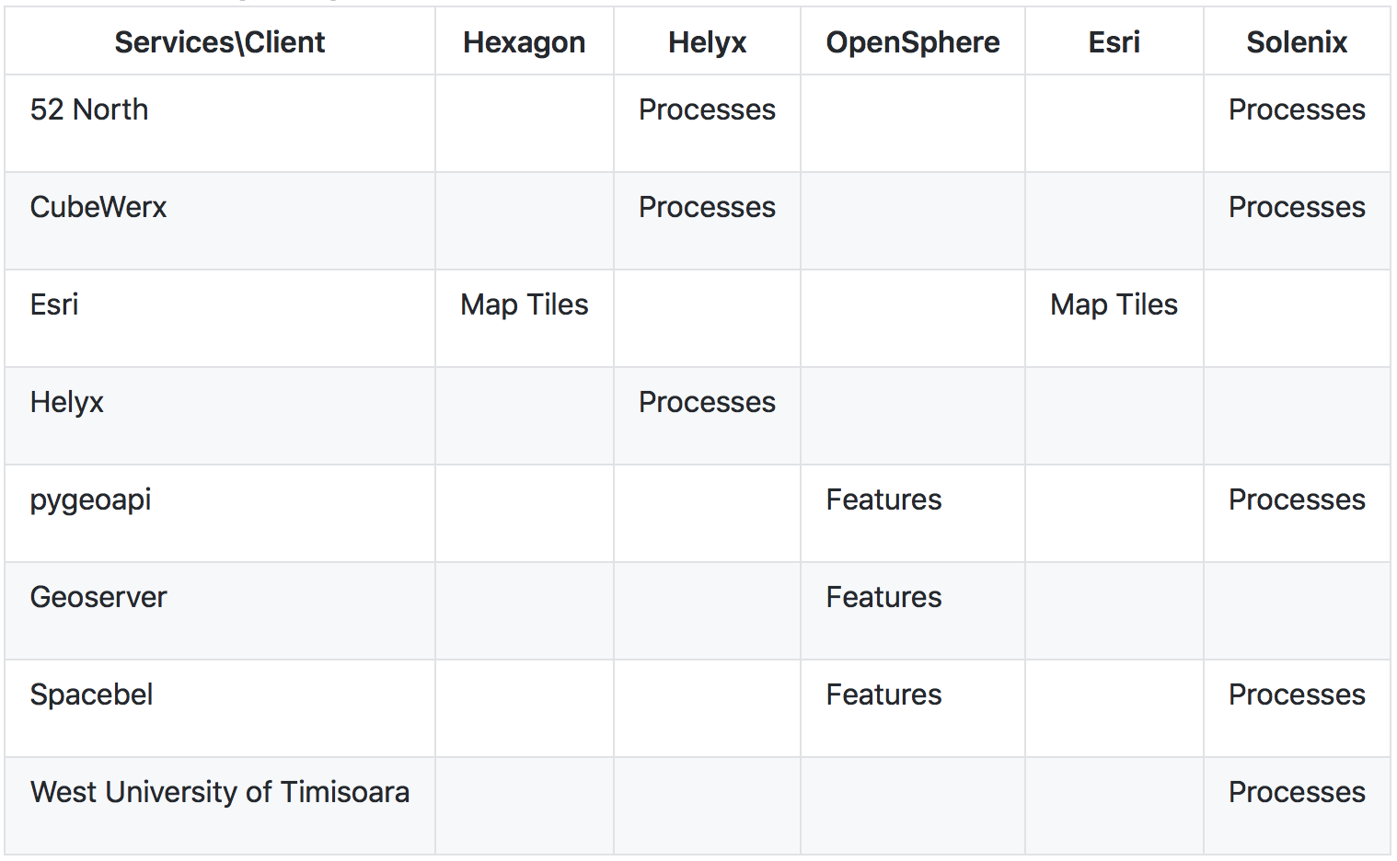
Technology Integration Experiments (TIE)

